Slide 1
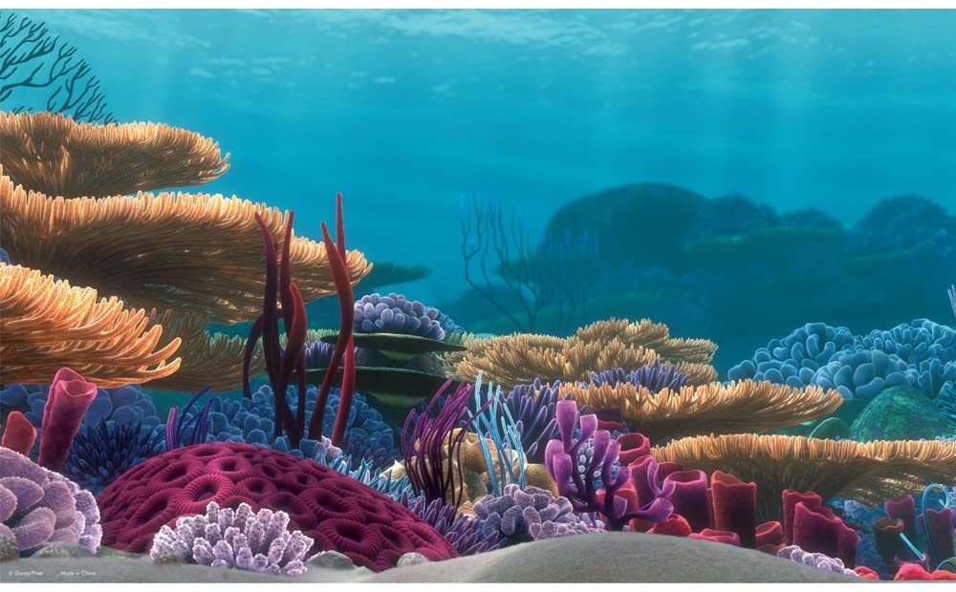
Simulating coral growth in 2D
Group 4 KoraalKnakkers
Marlon de Jong
Charlotte Kaandorp
Tim Müller
Malou Sprinkhuizen

Slide 2
TABLE OF CONTENTS
01
02
03
04
05
06
INTRODUCTION
RESEARCH QUESTION
AND HYPOTHESIS
MODEL
METHODOLOGY
ANALYSIS METHODS
RESULTS AND DISCUSSION

Slide 3
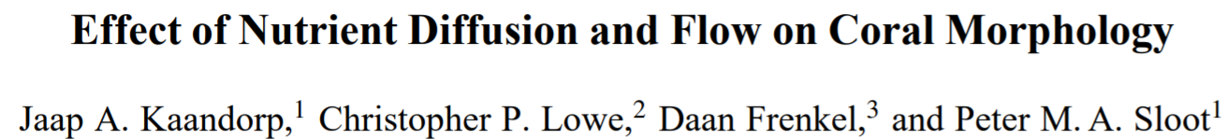
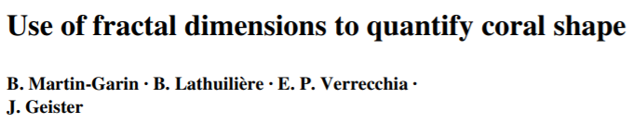
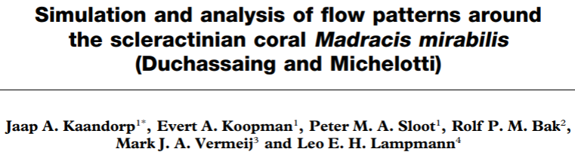
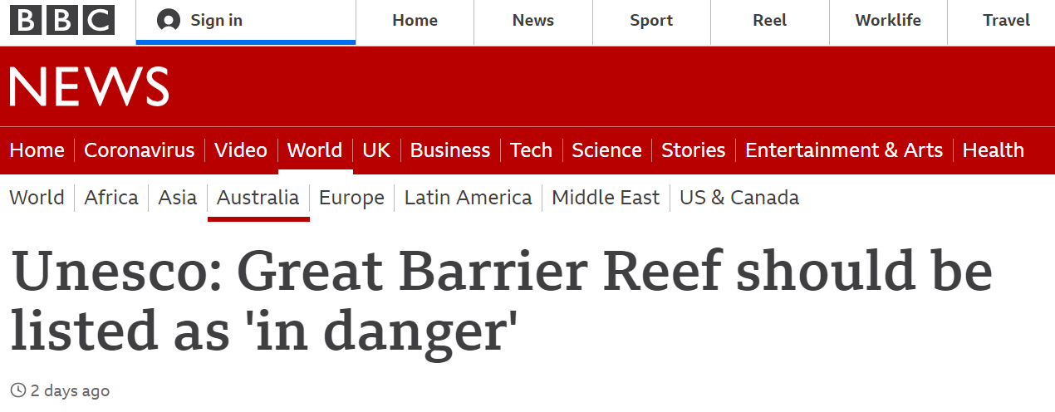
INTRODUCTION

Slide 4
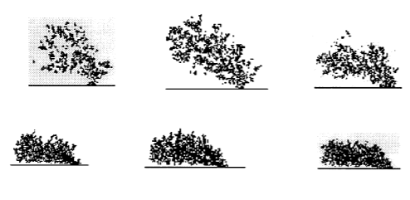
How is the growth of coral influenced by its dependence on sunlight and nutrition?
Sunlight
Nutrients
Flow
Erosion
Research Question
Hypothesis
Kaandorp, J. A., Lowe, C. P., Frenkel, D., & Sloot, P. M. (1996). Effect of nutrient diffusion and flow on coral morphology. Physical Review Letters, 77(11), 2328.

Slide 5
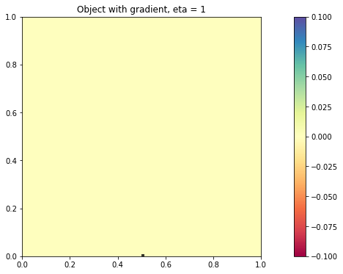
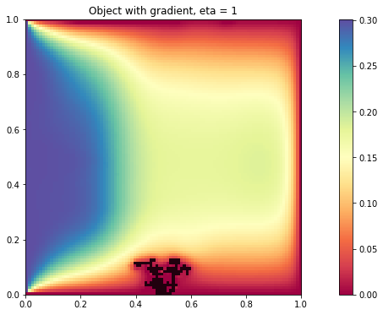
MODEL SET-UP
2D box of size 100 by 100
Source cell at center bottom
Environmental factors influence the chance of growth
Each step one coral cell is added to the model
Model stops after 100 iterations
Flow carrying nutrients comes from left

Slide 6
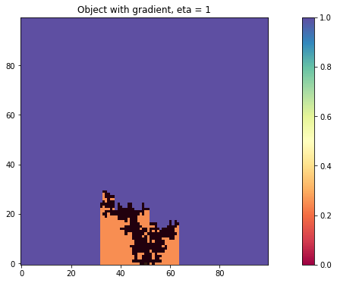
SUNLIGHT
Homogeneous initial concentration
Shadow
Reflection
Too small for sensible luminescence difference

Slide 7
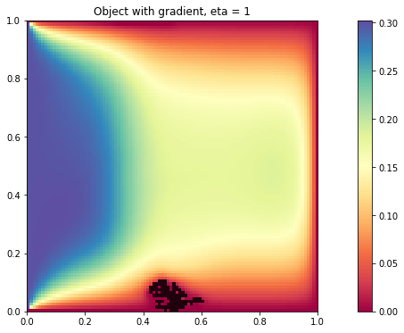
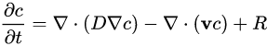
NUTRIENTS
Advection-diffusion equation
Boundaries: sink at top, bottom, right; left-side source
Displaced by flow + diffusion
Finite-differencing method

Slide 8
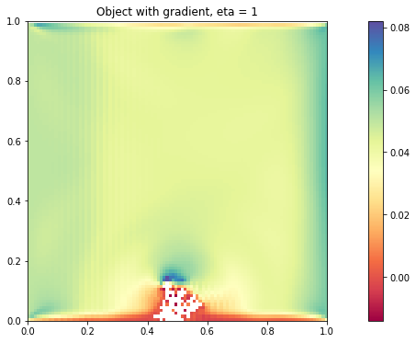
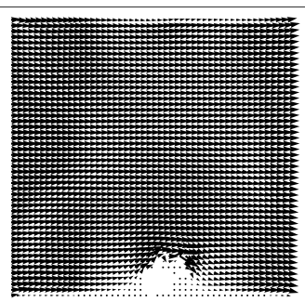
FLOW
Lattice Boltzmann Method (indirect Navier Stokes), lbmpy package
Initial velocity field
Inflow from left side of environment
Boundaries: outflow, no-slip at bottom
Flow strength is stable

Slide 9
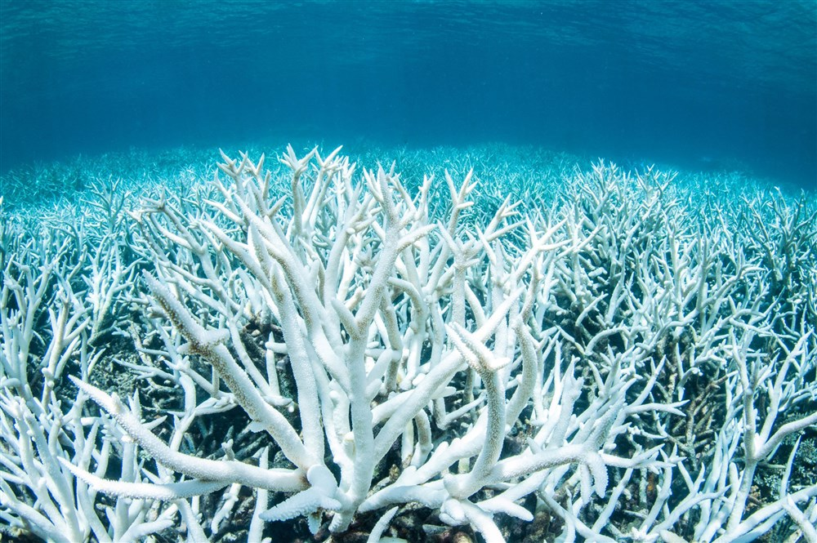
EROSION
Pressure by flow
Coral cell dissolves
Check which cells have connection with source cell

Slide 10
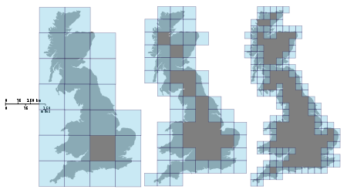
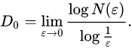
DENSITY ANALYSIS
Fraction of cells on edge (branch fraction)
Fractal dimensions (estimation using box-counting method)

Slide 11
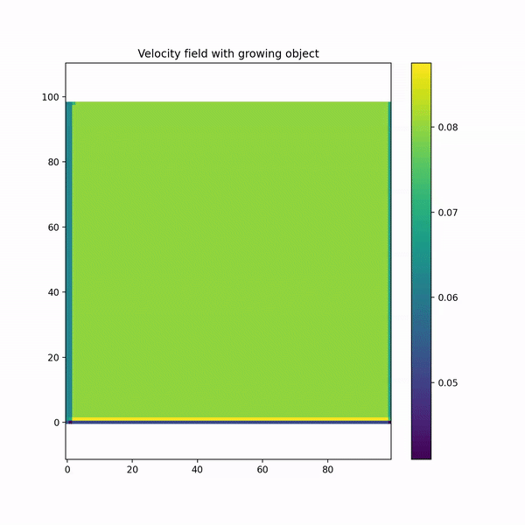
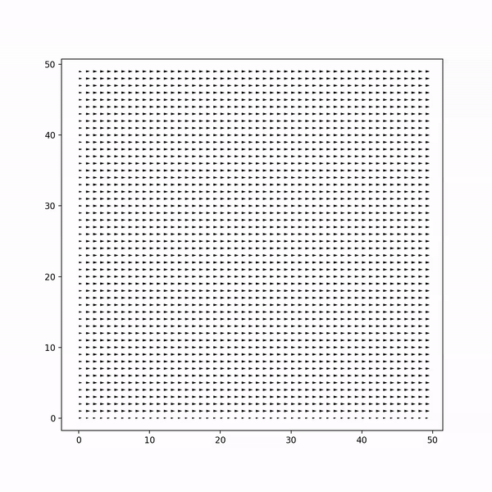
DEMO GROWTH
PLACEHOLDER FOR IMAGES WHICH SHOW DENS AND NON-DENSE CORAL STRUCTURE

Slide 12
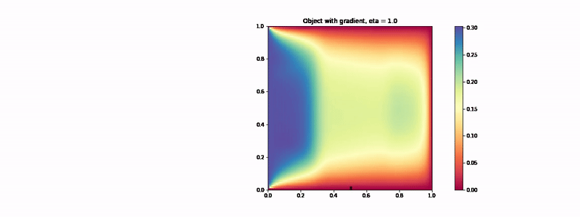
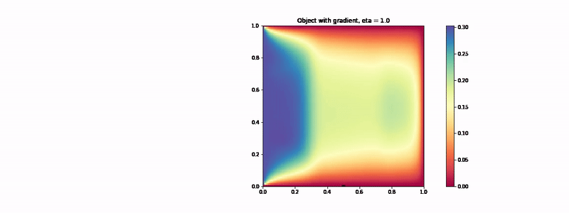



RESULTS SUNLIGHT AND NUTRIENTS
Alpha = 0.0
Alpha = 0.25
Alpha = 0.5
Alpha = 0.75
Alpha = 1

Slide 13
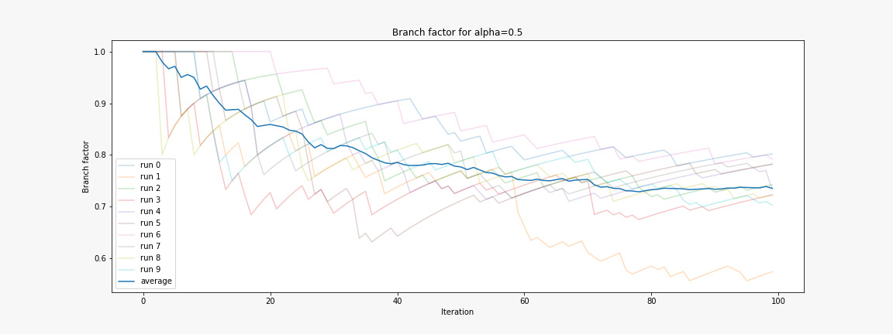
SUNLIGHT AND NUTRIENTS BRANCH FACTOR

Slide 14
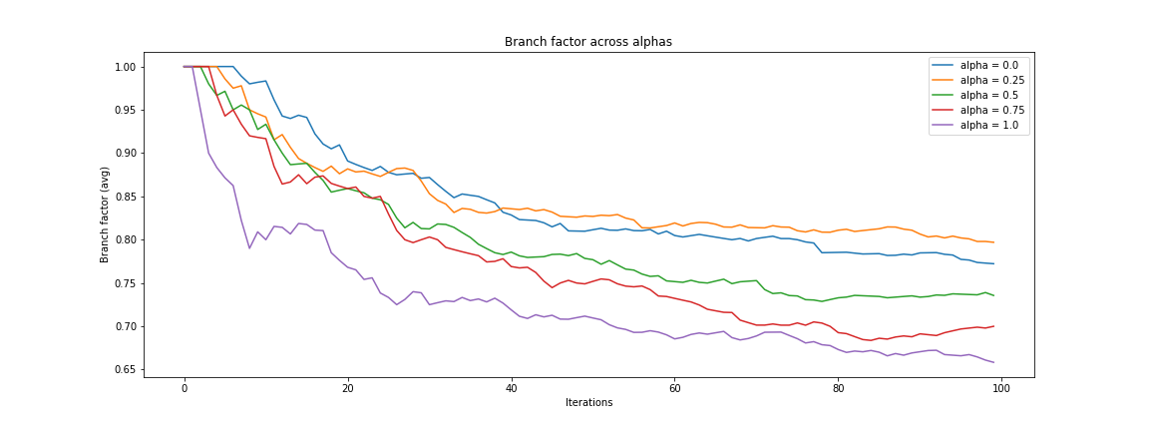
SUNLIGHT AND NUTRIENTS BRANCH FACTOR
PLACEHOLDER FOR graphs fractal dimension and branch factor

Slide 15
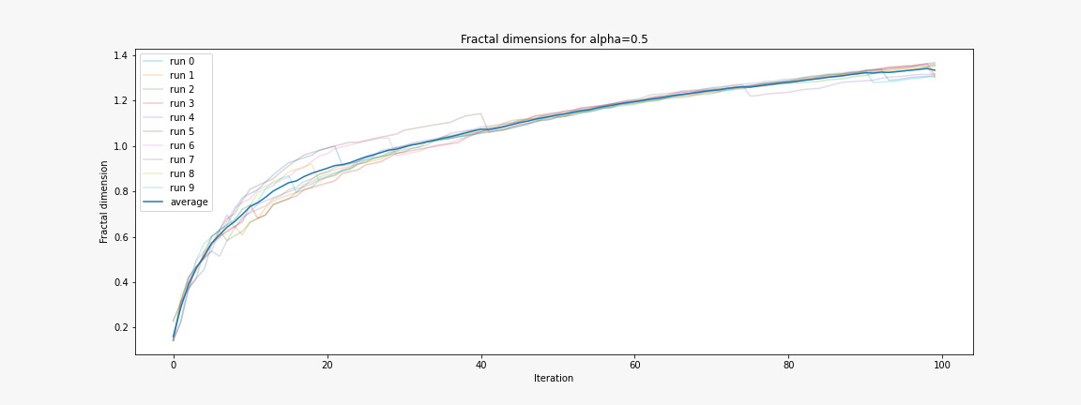
SUNLIGHT AND NUTRIENTS FRACTAL DIMENSION
PLACEHOLDER FOR graphs fractal dimension nd branch factor

Slide 16
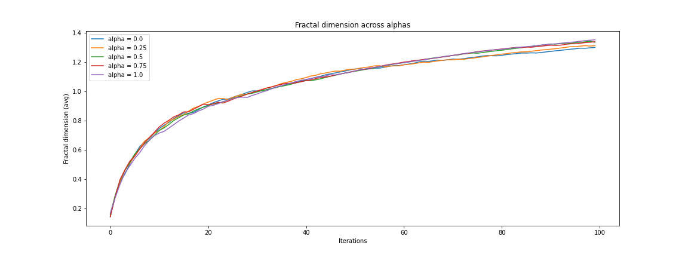
SUNLIGHT AND NUTRIENTS FRACTAL DIMENSION

Slide 17





RESULTS EROSION
threshold = 0.0
threshold = 0.1
threshold = 0.0503
threshold = 0.0505
threshold = 0.0507

Slide 18





RESULTS EROSION
threshold = 0.0
threshold = 0.1
threshold = 0.0503
threshold = 0.0505
threshold = 0.0507

Slide 19
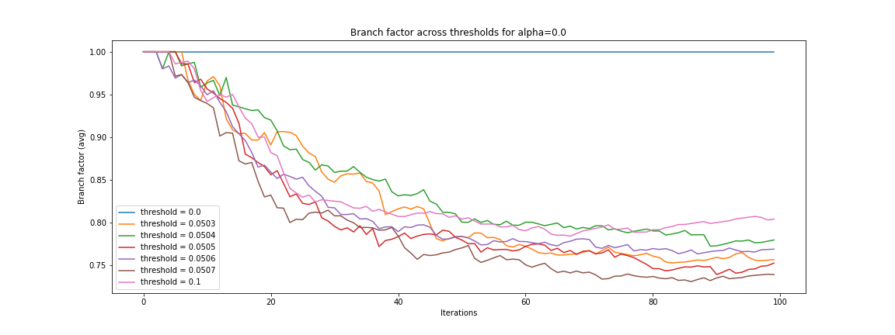
RESULTS EROSION

Slide 20
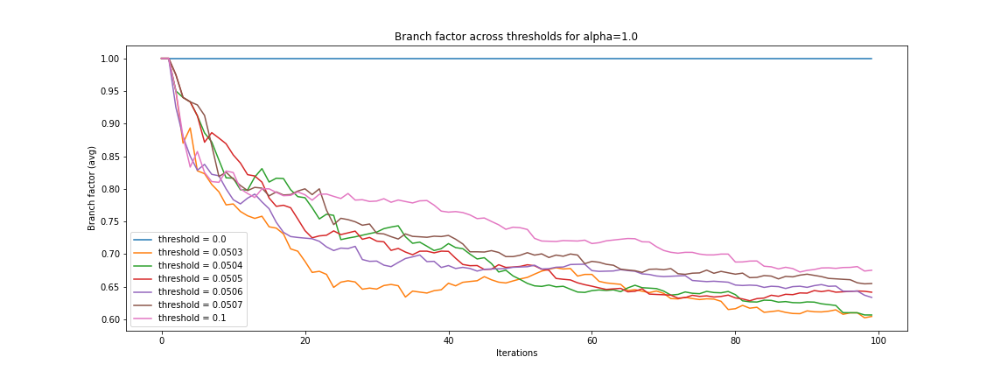
RESULTS EROSION

Slide 21
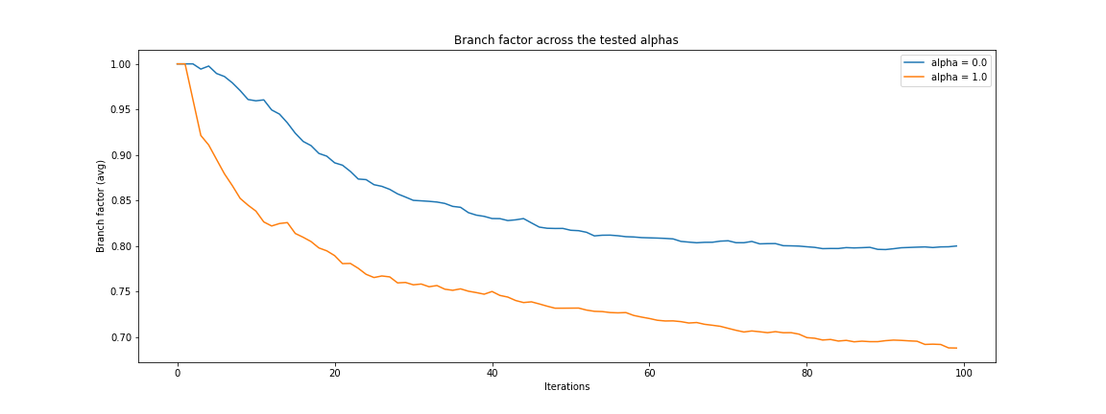
RESULTS EROSION

Slide 22
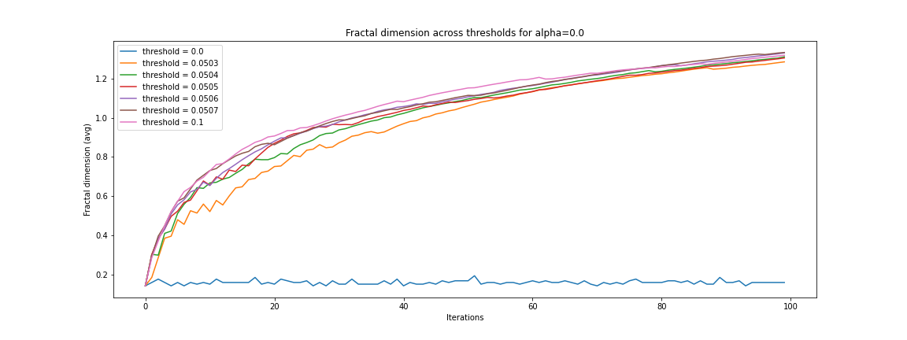
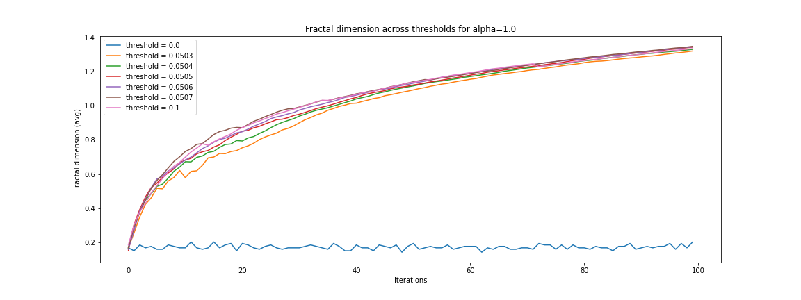
RESULTS EROSION

Slide 23
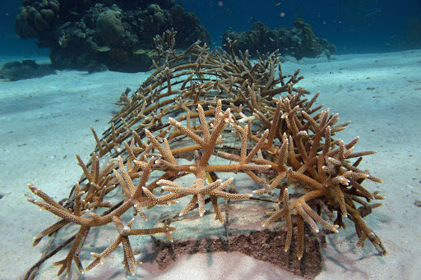
DISCUSSION
Coral breaking would influence the environment
Nutrient concentration has sink on all sides but left
2D makes a lot of assumptions
- Nutrients cannot go around or through coral
- Sunlight does not reflect or vary in intensity
Flow is constant
other works??? kekke pics van breaking stuff
zon doorschijnen naar andere plekken

Slide 24
Thank you for listening
Questions?
Group 4
KoraalKnakkers
Marlon de Jong
Charlotte Kaandorp
Tim Müller
Malou Sprinkhuizen

Slide 25
APPENDIX

Slide 26
REFERENCES
APPENDIX
Martin-Garin, B., Lathuilière, B., Verrecchia, E.P. et al. Use of fractal dimensions to quantify coral shape. Coral Reefs 26, 541–550 (2007)
Kaandorp J.A., Filatov M., Chindapol N. Simulating and Quantifying the Environmental Influence on Coral Colony Growth and Form. In: Dubinsky Z., Stambler N. (eds) Coral Reefs: An Ecosystem in Transition. Springer, Dordrecht (2011)
Kaandorp Jaap A., Koopman Evert A., Sloot Peter M. A., Bak Rolf P. M., Vermeij Mark J. A. and Lampmann Leo E. H. Simulation and analysis of flow patterns around the scleractinian coral Madracis mirabilis (Duchassaing and Michelotti)Phil. Trans. R. Soc. Lond. B3581551–1557 (2003)
Jaap A. Kaandorp, Christopher P. Lowe, Daan Frenkel, and Peter M. A. Sloot Effect of Nutrient Diffusion and Flow on Coral Morphology (1996)

Slide 27
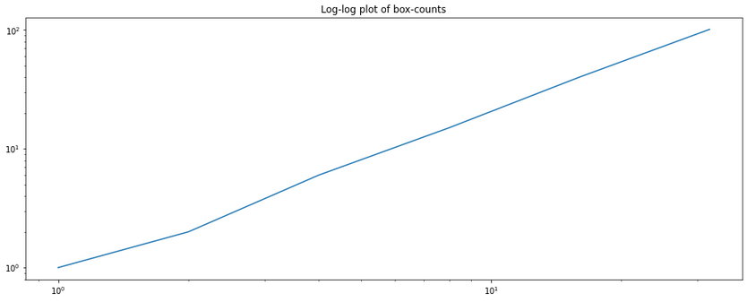
FRACTAL DIMENSION
APPENDIX
Figure 1: Plot of the fractal dimension for various alpha’s. This time, it’s plotted on a log-log scale to check the validity of the dimension: we should see a straight line, which we kinda see.

